Slide 1
Introductory General Chemistry
Chemistry 3A
Experiment 10a
Types of Reactions
Mitch Halloran

Slide 2
Introduction
There are countless chemical reactions that can occur
But reactions fall within certain types, certain categories
This experiment is about studying one of each reaction that falls within a certain type or category

Slide 3
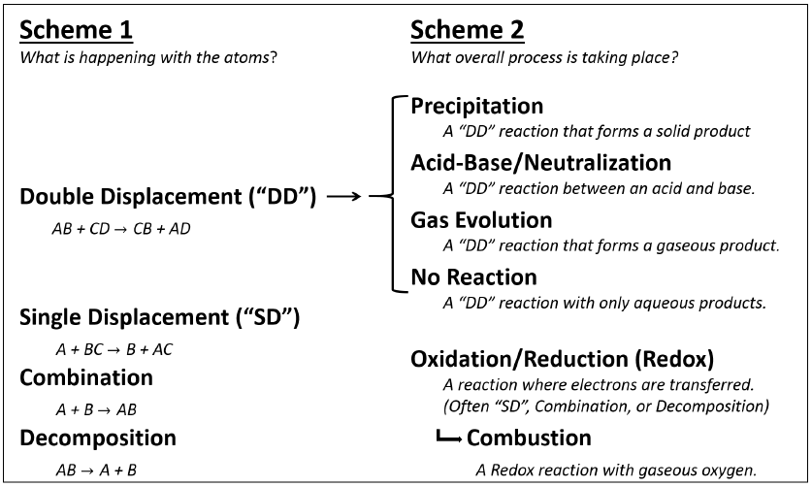
Background
With the types/categories of reactions, two “schemes” emerge
Scheme 1 is “what happens with atoms?” Scheme 2 is about process

Slide 4
Background
With the types/categories of reactions, two “schemes” emerge
Scheme 1 is “what happens with atoms?”
Double displacement (DD), single displacement (SD), combination, decomposition
Scheme 2 is about process: precipitation (DD), neutralization (DD), gas evolution (DD), dissolution only; redox, combustion
Precipitation
Salt (aq) + Salt (aq) | → | New Salt (s) + New Salt (aq)
2 NaCl (aq) + Pb(NO₃)₂ (aq) | → | PbCl₂ (aq) + 2 NaNO₃ (aq)
Acid-Base / Neutralization
Acid (aq) + Base (aq) | → | Salt (aq) + Water (l)
HNO₃ (aq) + KOH (aq) | → | KNO₃ (aq) + H₂O (l)

Slide 5
Background
Gas Evolution
Salt (aq) + Acid (aq) | → | New Acid (s) + New Salt (aq)
New Acid (aq) | → | Gas (g) + Water (l)
Na₂SO₃ (aq) + 2 HCl (aq) | → | H₂SO₃ (aq) + 2 NaCl (aq)
H₂SO₃ (aq) | → | SO₂ (g) + H₂O (l)
No Reaction
The mixing of compounds in aqueous solution can sometimes result in none of the reactions mentioned

Slide 6
Background
Oxidation-Reduction (Redox)
2 Na (s) + 2 H₂O (l) | → | H₂ (g) + 2 NaOH (aq)
2 Al (s) + 3 Cl₂ (g) | → | 2 AlCl₃ (s)
Cu (s) + Pd(NO₃)₂ (aq) | → | Pd (s) + Cu(NO₃)₂ (aq)
Combustion
Hydrocarbon (g,l,s) + Oxygen (g) | → | Carbon Dioxide (g) + Water (g)
C₂H₄ (g) + 3 O₂ (g) | → | 2 CO₂ (g) + 2 H₂O (g)
Metal (s) + Oxygen (g) | → | Metal Oxide (s)
2 K (s) + O₂ (g) | → | K₂O (s)

Slide 7
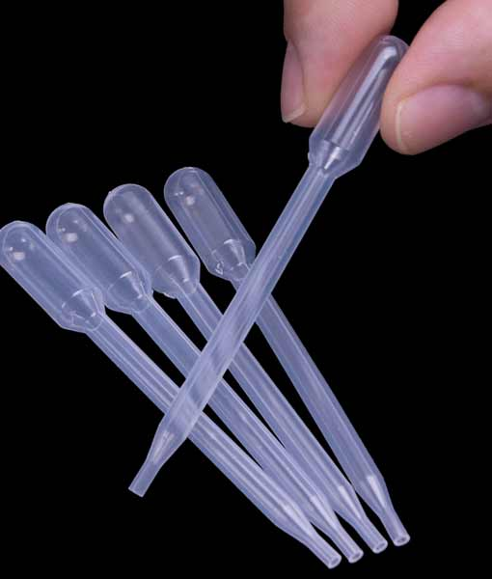
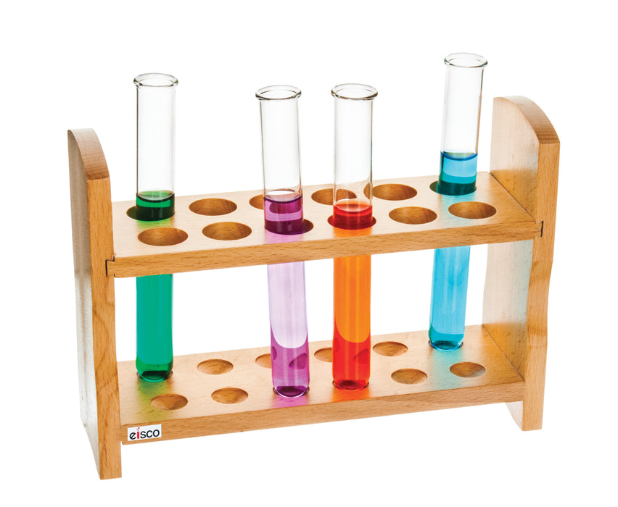
Equipment You Will Use

Slide 8
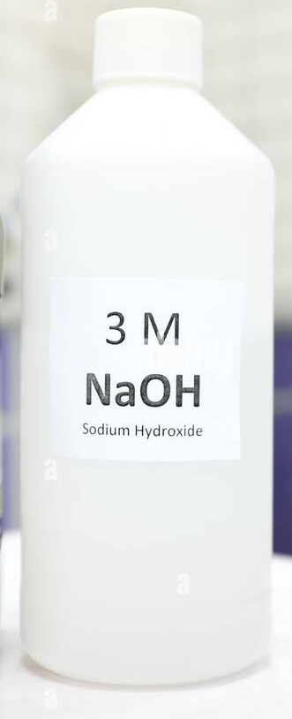
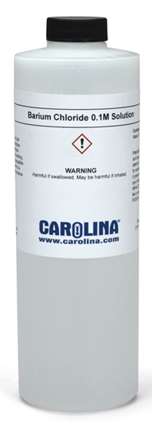
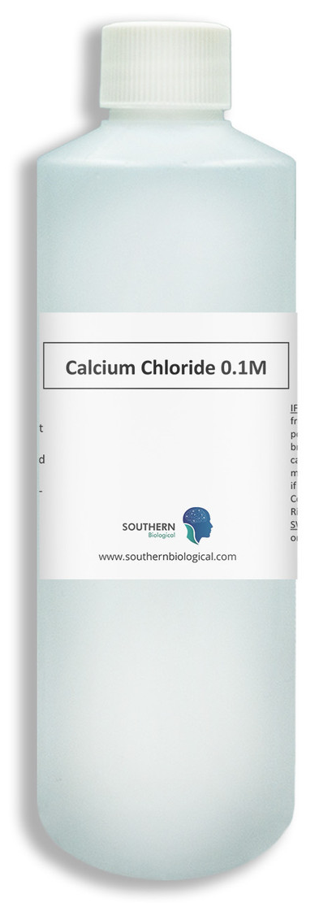
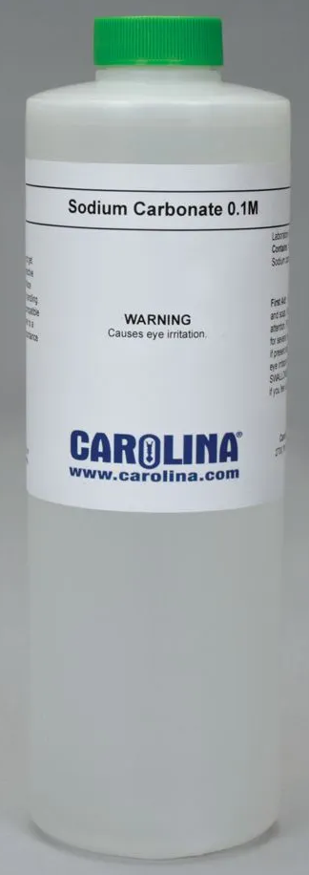

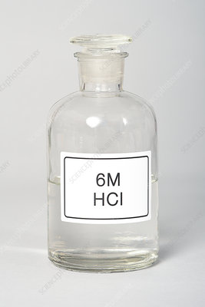
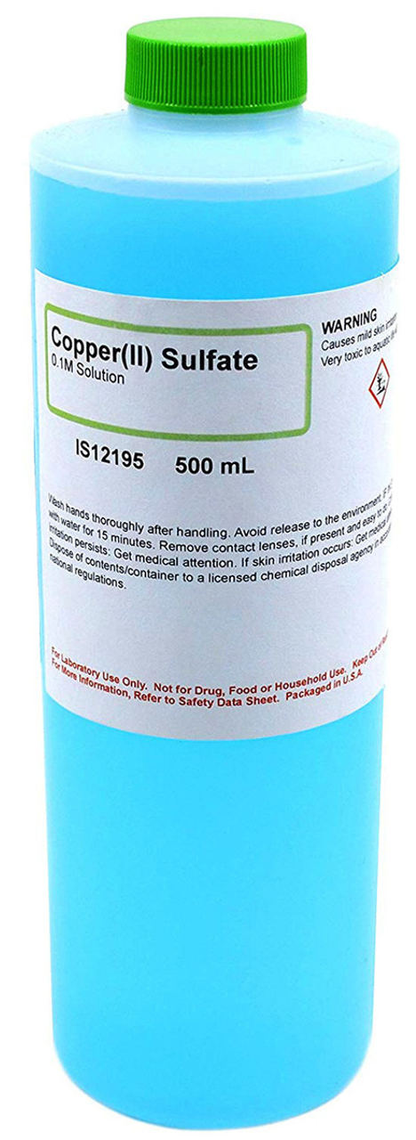
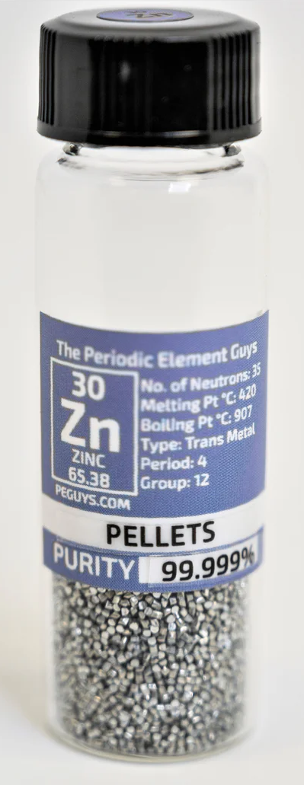
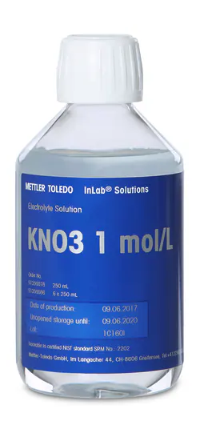
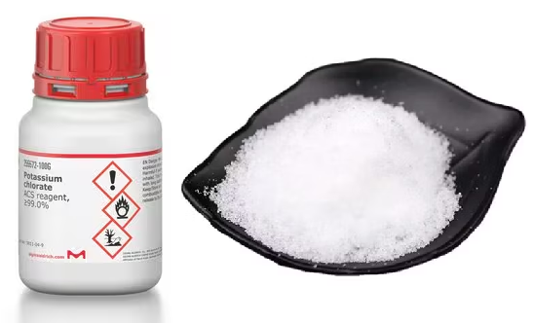
Consumables

Slide 9
Procedure
All reactions will be done in test tubes. Do not concern yourself with measuring out exact quantities
Consider “1 mL reagent” to ~20 gtt (drops) from a transfer pipet or a finger width in height in the test tube
1 g reactant is about a pea size: don’t weigh in balance
Complete the stations in any order
Waste containers are provided: do not dump in sink unless given instructions

Slide 10
Procedure
Station 1
Place ~3 mL 6.0 M HCl in tube
Add a few Zn pellets, record observations
Get another empty test tube, invert it over reaction tube. Hold capture tube at angle still upside down, light a match and bring it to mouth of tube. What happens?
Station 2
Place 1 mL 0.1 M BaCl2 in tube
Add 1 mL 0.1 M Na2SO4 to it, and mix/swirl. Record observation
Wait 3-5 minutes and record observation: what is the insoluble product?
While you are waiting at last step, perhaps go to another station and start that experment

Slide 11
Procedure
Station 3
Place 1 mL 0.1 M BaCl2 in tube
Add 1 mL 0.1 M Na3PO4 to it, and mix/swirl. Record observation
Wait 3-5 minutes and record observation: what is the insoluble product?
While you are waiting at last step, perhaps go to another station and start that experiment
Station 4
Place 2 mL 1.0 M Na2CO3 in tube
Add 1 mL 6 M HCl to it, and mix/swirl. Record observation
If you observe a gas, what is the gas. What is the reaction equation?

Slide 12
Procedure
Station 5
Place ~1 g (small scoop) of KClO3 in tube.
Grab the tube with a clamp at the TOP of the tube
In the fume hood, hold the tube at an angle and heat ONLY the bottom of the tube with blue cone flame of Bunsen burner. Let the KClO3 melt, let it bubble, and heat until nothing happens
Did anything come out of tube tube. Record observations.
Station 6
Mix 1 mL 0.1 M CaCl2 with 1 mL 0.1 M Na2CO3
Record immediate observations. Then record observations after 3-5 minutes. Use the solubility tables to determine what product formed.

Slide 13
Procedure
Station 7
Mix 1 mL 6.0 M HCl with 2 mL 3.0 M NaOH
Record observations. Were there temperature changes (use your hand/fingers carefully to see if the mixture is cold or hot). Use understanding of chemistry to predict product(s)
Station 8
Mix 1 mL 0.1 M KNO3 with 1 mL 0.1 M BaCl2
Record immediate observations. Then record observations after 3-5 minutes. Use the solubility tables to determine what product formed.

Slide 14
Procedure
Station 9
Transfer 2 mL of 0.1 M CuSO4 to tube
Add a few Zn pellets. Record immediate observations and after 3-5 minutes. Check if there are solid products what they look like. What accounts for the blue color?
Station 10
Mix 1 mL 4.0 M NH4Cl with 1 mL 3.0 M NaOH. If there is a gas, what is it?
Moisten red litmus and hold it over the mouth of the tube: what is the color change and what causes it?
Take 2 fingers and waft the air from tube toward yourself: is there any strong odor? Do NOT put your nose or face over the tube!

Slide 15
Example Data Analysis
Suppose A=23.7584 g, B=34.3532 g, C=37.5732 g. After the reaction, D=36.7841 g
[B-A]=10.5948 g, [C-B]=3.2200 g, [D-A]=13.0257 g
Copper reacted should be same as initial copper, because copper doesn’t go anywhere
Sulfur reacted should be [D-A]-[B-A]=13.0257 g - 10.5948 g= 2.4309 g
Excess sulfur = [C-B]-2.4309 g = 3.2200 g – 2.4309 g =0.7891 g
Mass ratio = copper/sulfur reacted = 10.5948 g/2.4309 g = 4.3583

Slide 16

Example Data Analysis
What does the mass ratio show?
For every 1 g of S, there are about 4.4 g Cu
Look at the molar masses of S and Cu.
If there are 32.065 g/mol S and 63.546 g/mol Cu, and there are 2 mol Cu and 1 mol S in Cu₂S, then what is the theoretical mass ratio of S to Cu in Cu₂S?
$$\frac{\frac{\text{63.546 }\text{g} \text{Cu}}{\text{mol} \text{Cu}}\text{×}\text{2 }\text{mol} \text{Cu}}{\frac{\text{32.065 }\text{g} \text{S}}{\text{mol} \text{S}}\text{×}\text{1 }\text{mol} \text{S}}=\frac{\text{3.9636 }\text{g} \text{Cu}}{\text{1 }\text{g} \text{S}}$$
4.4 g Cu/g S seems close to 4.0 g Cu/g S. How close can you get?

Slide 17
Clean Up

